Slide 1



Afterschool English
: Curriculum Overview
2019.11

Slide 2




Differentiator
1
2
3
media-rich
learning platform
& APP
APP-based immersive media experience
integrated skill
approach

Slide 3
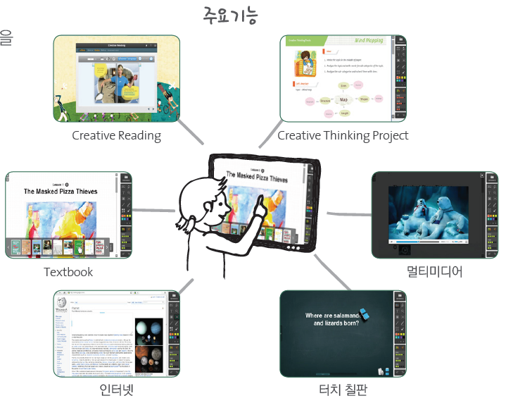


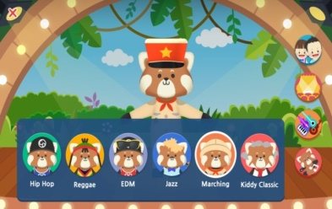

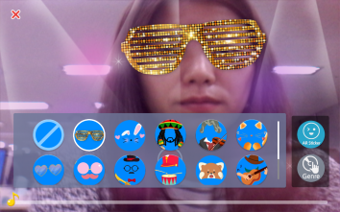


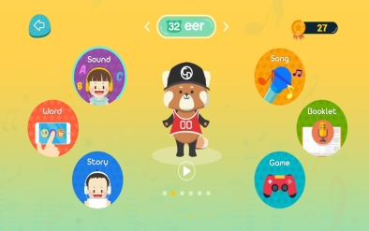
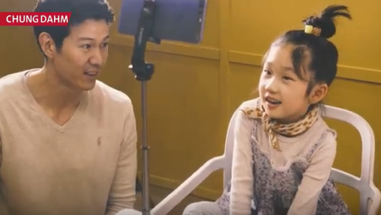
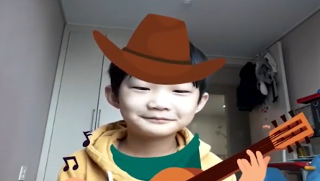
Learning Platform & Immersive Media Experience
audio
resources
textbook
multimedia
internet
smart board
media-rich
learning platform & APP
APP-based
immersive media experience
*APP Usage (Only Level 1 & 2)

Slide 4


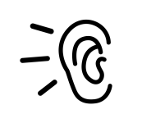

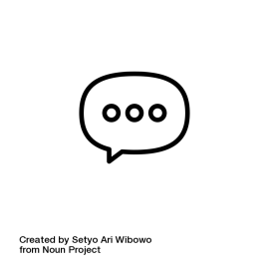
Integrated Skill Approach (1/2)
Segregated vs. Integrated Skill Approach
VS
independent instruction/activities
for each skill
linked instruction/activities
for 4 skills

Slide 5




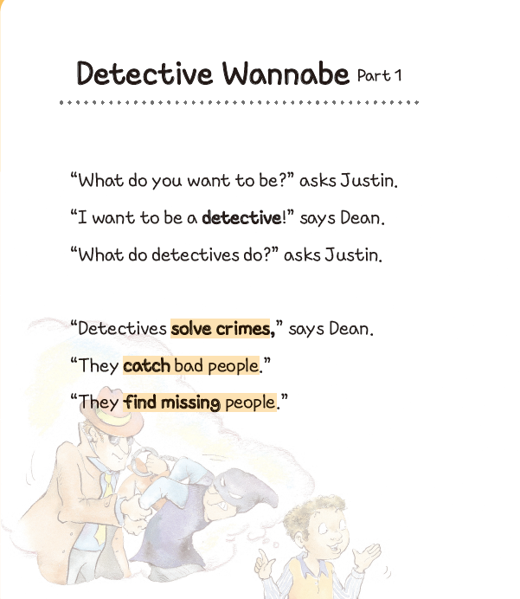
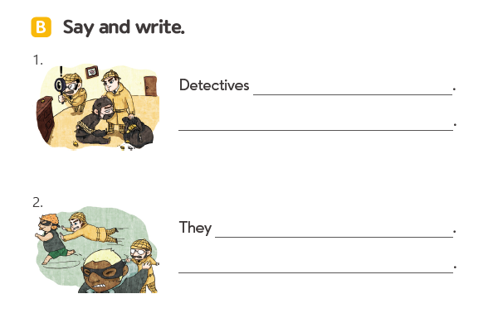
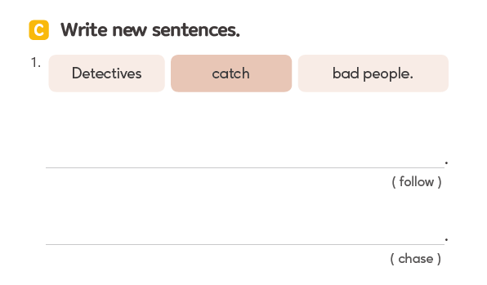
Integrated Skill Approach (2/2)
Topical Link: Detectives, Detective Wannabe
EFL
Receptive Skills
ESL
Productive Skills
Detectives follow bad people.
Detectives chase bad people.
Linguistic Link
    target words: detective, solve, crime, catch, find,
    target phrases: solve crime, catch bad people, find missing people

Slide 6
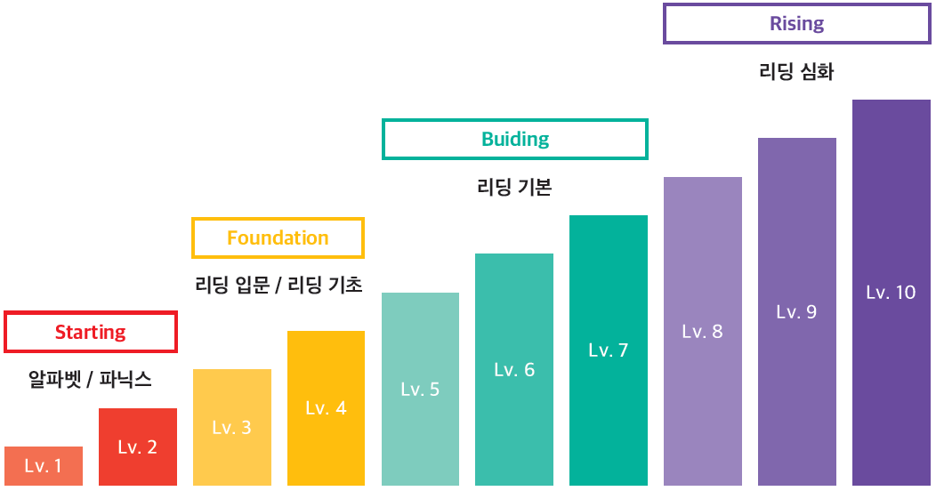
Curriculum
Phonics/Theme
Pre-reading
Reading (Early)
Reading (Fluent)

Slide 7
Level & Textbook
Grade | Level | Textbook | # of Lesson | Content | Word Count (per lesson) | US Grade
Grade 4-5 | Level 10 | 6 Sets | 24 Lessons | Fiction & Nonfiction | 80-120 | G2
 | Level 9 | 6 Sets | 24 Lessons
 | Level 8 | 6 Sets | 24 Lessons
Grade 3-4 | Level 7 | 6 Sets | 24 Lessons |  | 60-90 | G1
 | Level 6 | 6 Sets | 24 Lessons
 | Level 5 | 6 Sets | 24 Lessons
Grade 2 | Level 4 | 6 Sets | 24 Lessons | Picture-based Story | 30-70 | K-G1
 | Level 3 | 6 Sets | 24 Lessons
Grade 1 | Level 2 | 6 Sets | 24 Lessons | Phonics Thematic Words & Expression | N/A | K
 | Level 1 | 6 Sets | 24 Lessons

Slide 8
Level Overview
Stage | Starting | Foundation | Building | Rising
 | Phonics | Pre-reading | Reading
Level | L1-2 | L3-4 | L5-7 | L8-10
Learning Period | 1 year | 1 year | 1 and half year | 1 and half year
Concept | Systematic, explicit phonics Thematic words & expressions | Lay the foundation for basic comprehension Basic communication skills | Develop the foundation for basic comprehension Lay the foundation for fundamental speaking & writing skills | Increase the foundation for comprehension Fundamental speaking and writing skills
Textbook (6 sets per level) | 12 sets / 36 books | 12 sets / 24 books | 18 sets / 36 books | 18 sets / 36 books
 | Student Book Practice Book Theme Book | Student Book Practice Book | Student Book Practice Book | Student Book Practice Book
Loudclass & APP | Student Book Theme Book Phonics APP | Student Book | Student Book | Student Book
US Grade | K | K-G1 | G1 | G2
Korean Grade | G1 | G2 | G3-4 | G4-5
Notes:
“ Creativity & Arts “
창의와 예술
자유로운 상상과 예술적 감성 및 표현을
창의적 사고와 문제해결에 융합한
온오프라인 연계학습 프로그램으로
창의성과 표현력을 키워줍니다.
(창의적 문제해결 + 예술적 창조)

Slide 9
Learning Matrix
Level | Level 1-2 | Level 3-4 | Level 5-7 | Level 8-10
Stage | Phonics | Emergent | Early | Fluent
Key Content | Decodable Text Daily Expression | Story Conversation | Fiction Non-fiction | Fiction Non-fiction
US Grade | K | K-G1 | G1-2 | G2
Main Component | Phonics: - Letter Recognition - Sound & Words - Phonics Song Daily Expression: - Thematic Words/Key Phrases - Short Dialogue - Useful & Often Used Expressions | Vocabulary: - Vocabulary Recognition Listening & Reading: - Story Listening/Reading - Sentence Comprehension - Reading Comprehension Speaking & Writing: - Basic Speaking - Basic Writing | Knowledge Activation; - Topic intro Vocabulary: - Vocabulary Recognition with definition - Chunk Recognition Listening & Reading: - Story Listening/Reading - Reading Comprehension & Reading Skill Speaking & Writing: - Story Summary - Dialogue Creation - Sentence Structure - Sentence Writing | Knowledge Activation; - Topic intro Vocabulary: - Vocabulary Recognition with definition & word class - Chunk Recognition Listening & Reading: - Story Listening /Reading - Reading Comprehension & Reading Skill - Passage Summary Speaking & Writing: - Story Summary - Dialogue Creation - Sentence Structure - Paragraph Writing - Play Script/Newscast
 | Picture-related Various types of practice activities Phonics Songs | Picture-related Easy and simple types of RC questions Picture Description/Dialog | Various types of RC questions Picture Description/ Storytelling/Dialog Sentence and Story Writing | Expanded types of RC questions Storytelling/Presentation Play/News Report Paragraph Writing

Slide 10
Level 1&2: Phonics Scope & Sequence
Book | Unit | Level 1 |  | Level 2
Book 1 | 1 | The Alphabet | Aa, Bb | Long Vowels | Long a
 | 2 |  | Cc, DD |  | Long e
 | 3 |  | Ee, FF |  | Long I
 | 4 |  | Review (Aa-Ff) |  | Review (Long a, e, i)
Book 2 | 1 |  | Gg, Hh |  | Long o
 | 2 |  | Ii, Jj |  | Long u
 | 3 |  | Kk, Ll |  | Review 1 (Long Vowels)
 | 4 |  | Review (Gg-Ll) |  | Review 2 (Short & Long Vowels)
Book 3 | 1 |  | Mm, Nn | Double Letter Consonants | ll, ss, ff
 | 2 |  | Oo, Pp |  | zz, ch, sh
 | 3 |  | Qq, Rr |  | wh, th, ck
 | 4 |  | Review (Mm-Rr) |  | ph, ng, nk
Book 4 | 1 |  | Ss, Tt | Double Letter Vowels | oi, oy
 | 2 |  | Uu, Vv, Ww |  | ou, ow
 | 3 |  | Xx, Yy, Zz |  | oo
 | 4 |  | Review (Ss-Zz) |  | au, aw
Book 5 | 1 | Short Vowels | Short a | R-controlled Vowels | ar, er
 | 2 |  | Short e |  | or, ir, ur
 | 3 |  | Short i |  | air, are
 | 4
 |  |  | Review (Short a, e, i) |  | ear, eer
Book 6 | 1 |  | Short o | Two Sounds | y, ea
 | 2 |  | Short u |  | c, g
 | 3 |  | Review 1 (The Alphabet) | Silent Letters | kn, tch
 | 4 |  | Review 2 (Short Vowels) |  | mb, wr

Slide 11
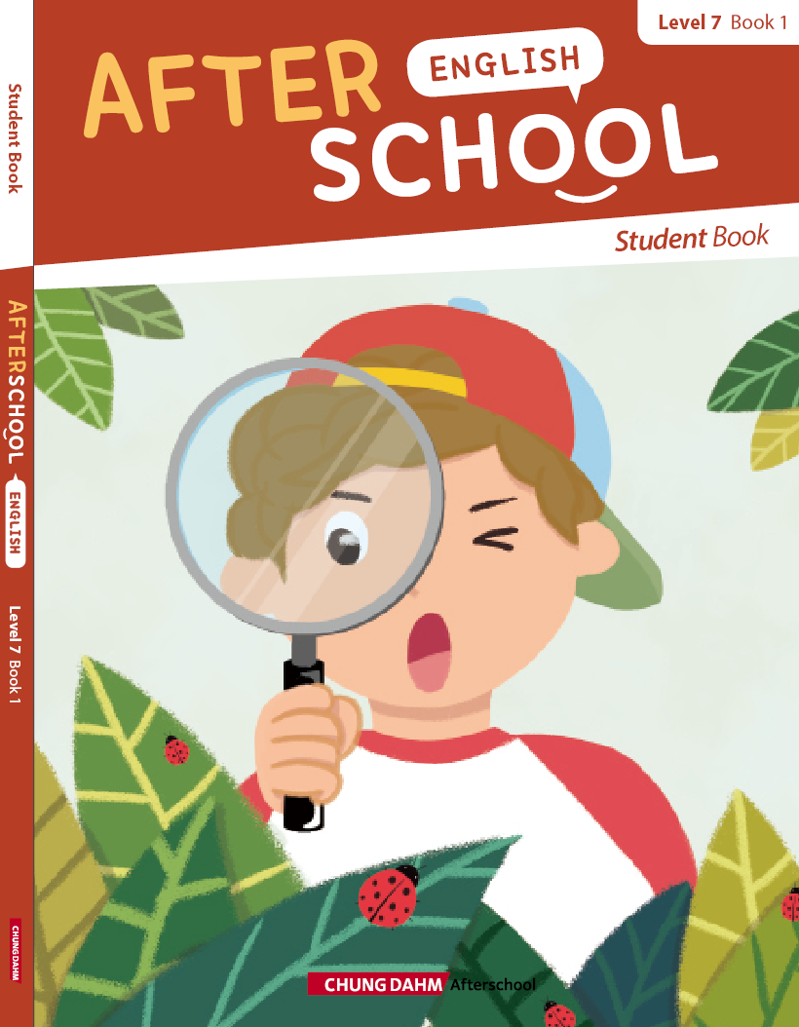
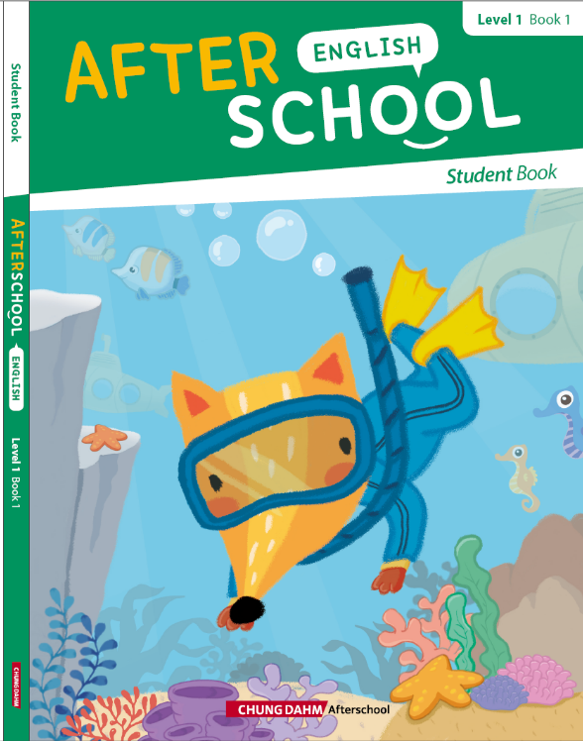


Textbook for Level 1-2
<Student Book>
engaging listening, reading, speaking, and writing activities
with creative, entertaining, and level-appropriate reading passages
<Practice Book>
constant and
cumulative review with
extension activities
and at-home practice
<Theme Book>
linking the English classroom
to the wider world and
motivating to speak English
with daily words and expressions

Slide 12
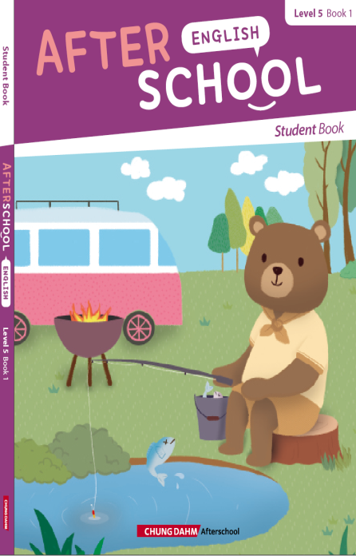
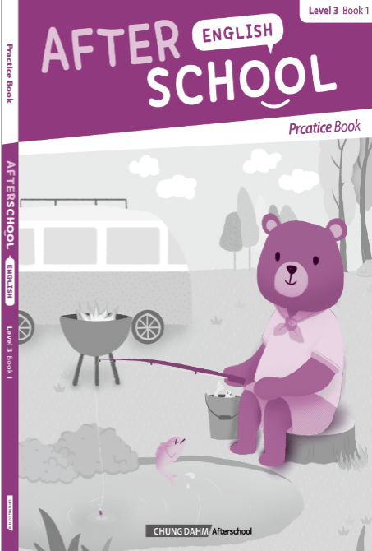
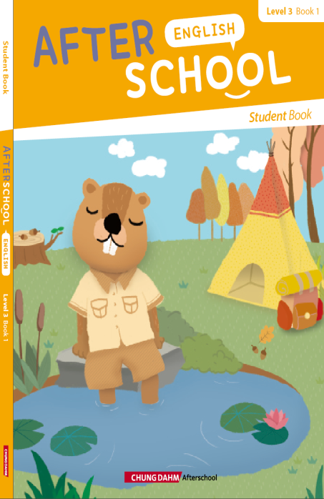

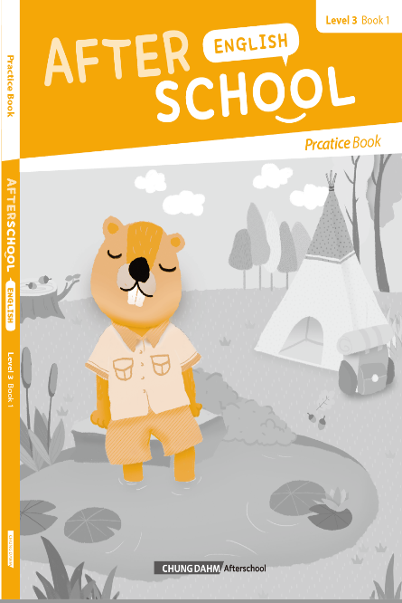
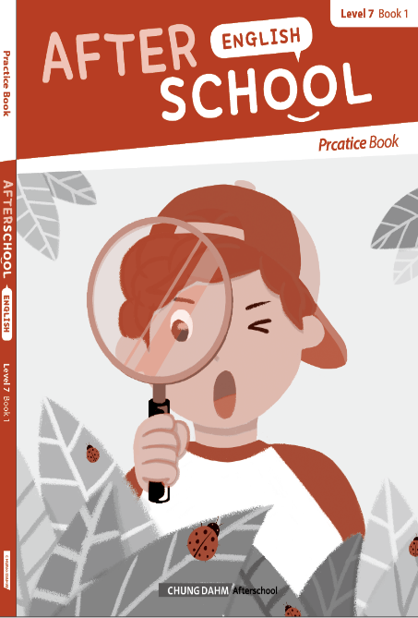
Textbook for Level 3-10
<Student Book>
engaging listening, reading, speaking, and writing activities
with creative, entertaining, and level-appropriate reading passages
<Practice Book>
constant and cumulative review with extension activities
and at-home practice

Slide 13
Concept for Phonics (Level 1&2)
Phonics program systematically designed for young students to develop
a comprehensive understanding of phonics and thematic words and expressions
Word
Decoding
Letter-Sound
Relationship
Systematic and explicit phonics skills
Thematic words and expressions
Main Context: Decodable Text &
Daily Expression
Immersive
Phonics Song
Daily Words & Expressions
Basic
Communicative Functions
Integrated Approach

Slide 14
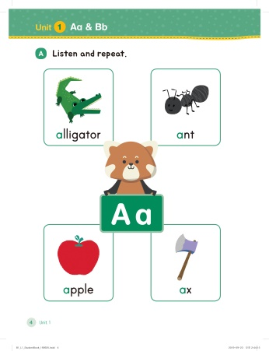
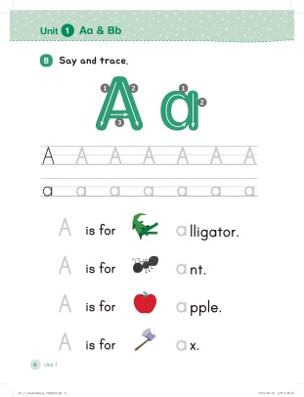
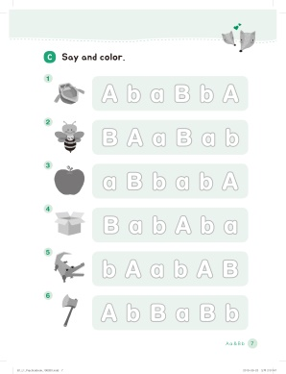
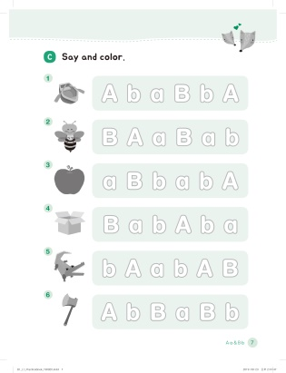
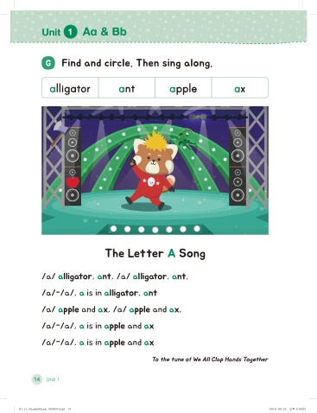
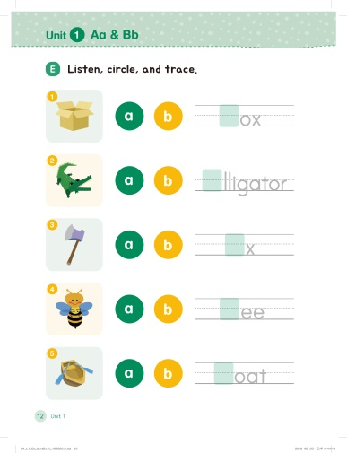
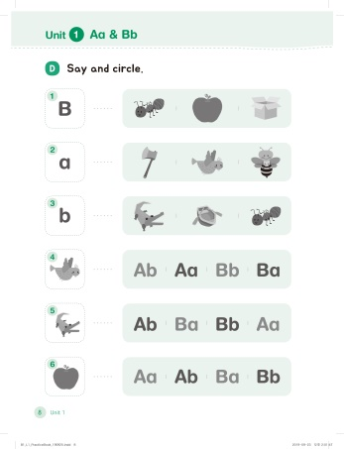
Learning Flow: Student Book & Practice Book (Level 1&2)
PHONICS
GPCs Introduction
Letter Formation
Letter Recognition
Letter and Sound Correspondence
Word Meaning/ Recognition
Sounds in Words/ Word Meaning
Phonics Song
* GPCs: Grapheme-phoneme correspondences

Slide 15
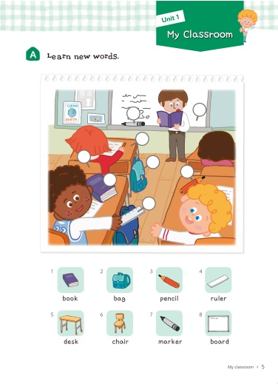
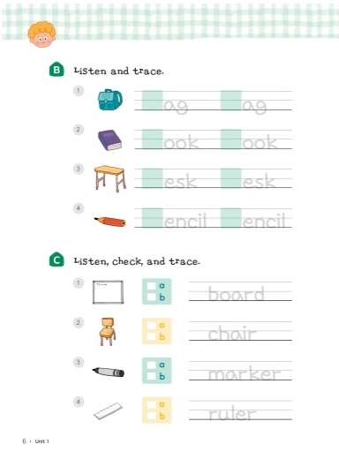
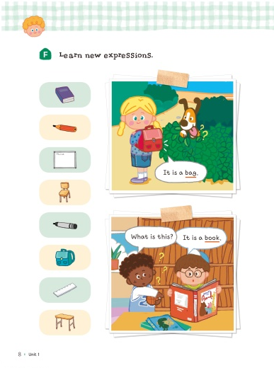

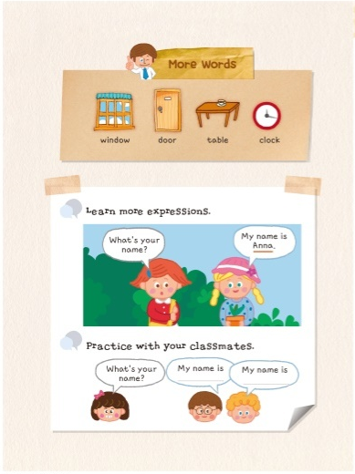
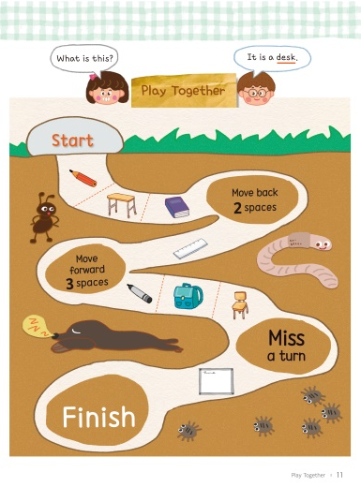
Learning Flow: Theme Book (Level 1&2)
Daily Expression
Word Intro & Practice
Word Practice
& Check-up
Expression Intro
& Practice
Expression Check-up
More Words & Expression Intro
Communication Games

Slide 16
Concept for Pre-Reading (Level 3&4)
Pre-reading program systematically designed
for young students with solid understanding of phonics
Sentence
Comprehension
Vocabulary
Recognition
Lay the foundation for basic comprehension
Basic communication skills
Reading
Comprehension
Main Context: Story
Basic
Writing
Basic
Speaking
Integrated Approach

Slide 17
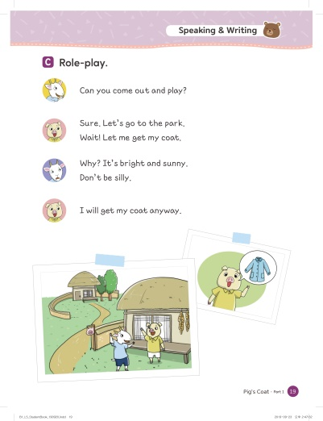
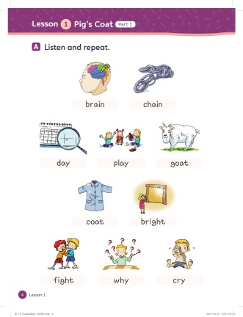
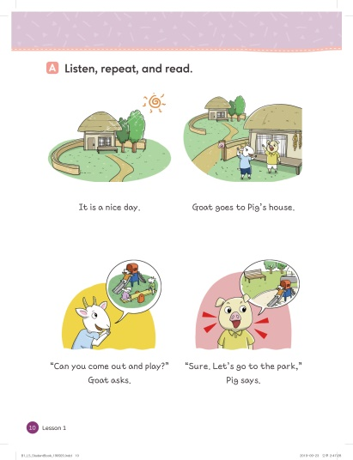
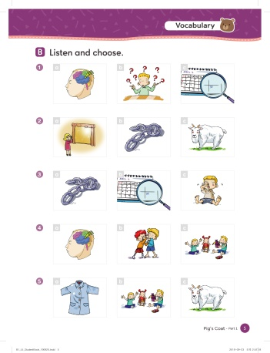
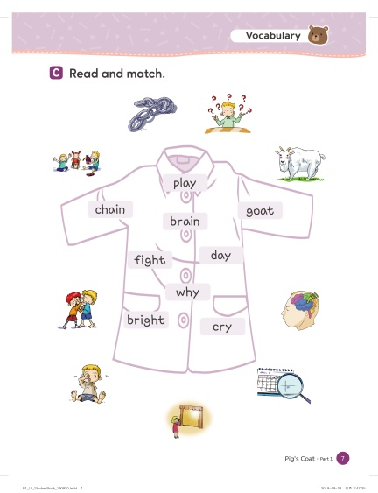
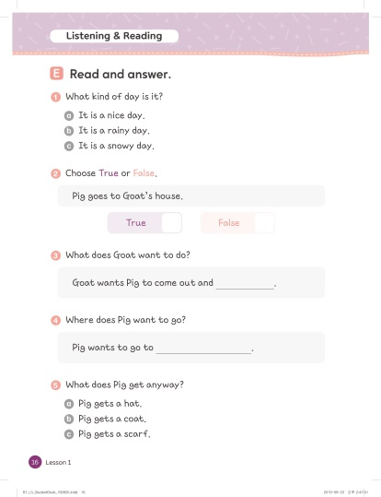
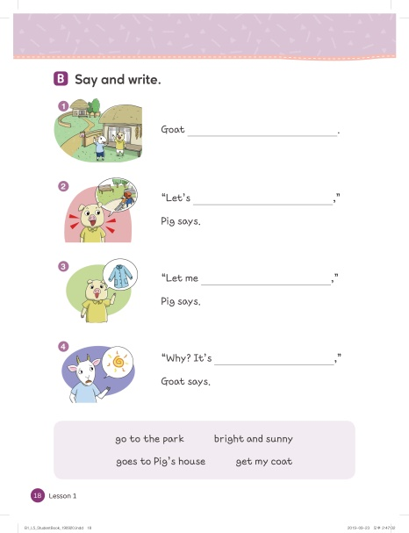
Learning Flow: Student Book & Practice Book (Level 3&4)
Vocabulary
Listening& Reading
Speaking & Writing
Word Intro & Practice
Sentence Comprehension
Basic Speaking
Word Recognition
Reading Comprehension
Basic Writing

Slide 18
Concept for Reading (Level 5-7)
Early Reading program systematically designed for students
to develop foundation for basic comprehension, fundamental speaking, and writing skills
Vocabulary w/definition
& Chunk Recognition
Knowledge Activation
Foundation for basic comprehension
Foundation for fundamental speaking and writing skills
Reading Comprehension & Reading Skill
Main Context: Story
(*Nonfiction:
Exposure ONLY)
Storytelling &
Dialogue Creation
Sentence Structure Recognition &
Summary Writing
Integrated Approach

Slide 19
Concept for Reading (Level 8-10)
Fluent Reading program systematically designed for students
to develop strong foundation for comprehension, fundamental speaking, and writing skills
Vocabulary w/definition & word class
& Chunk Recognition
Knowledge Activation
Strong foundation for comprehension
Fundamental speaking and writing skills
Reading Comprehension & Reading Skill
Main Context:
Fiction &
Nonfiction
Storytelling
/Presentation &
Dialogue Creation
Sentence Structure Recognition &
Paragraph Writing
Integrated Approach

Slide 20
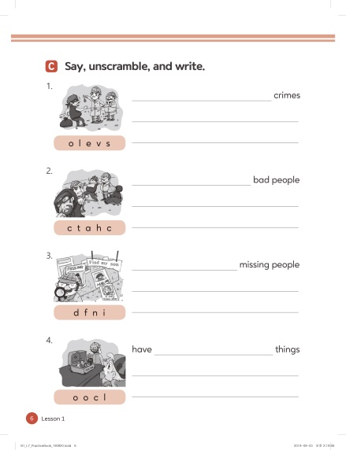
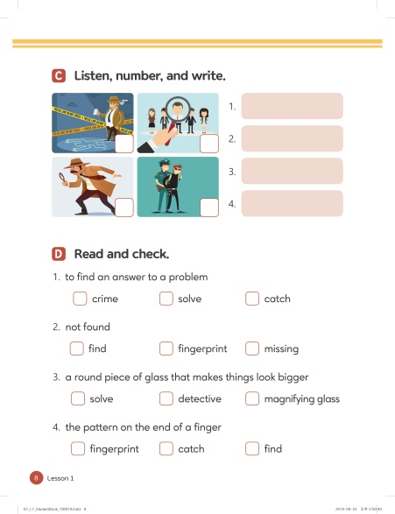
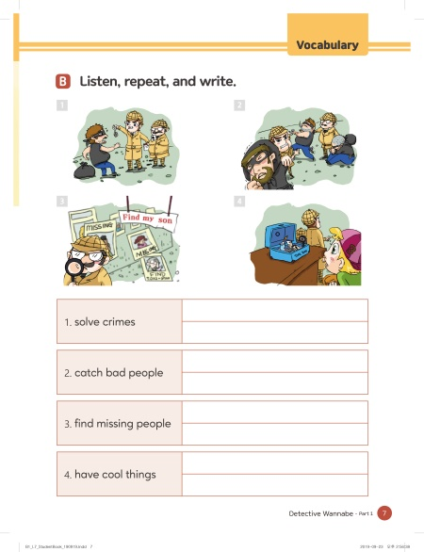
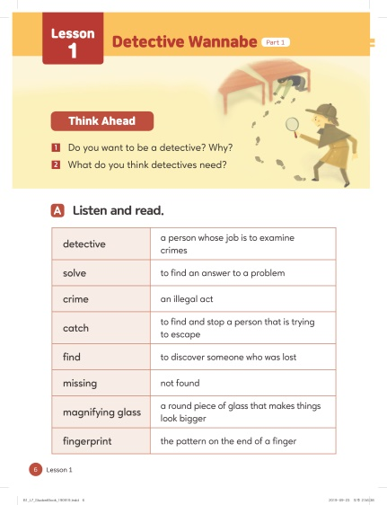
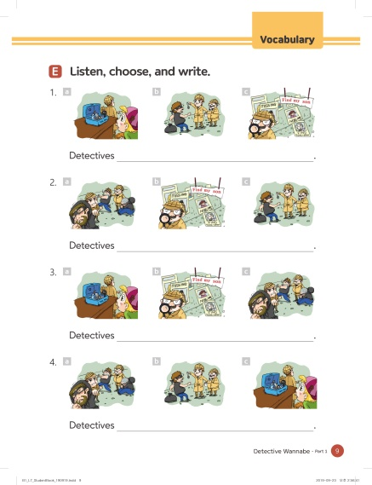
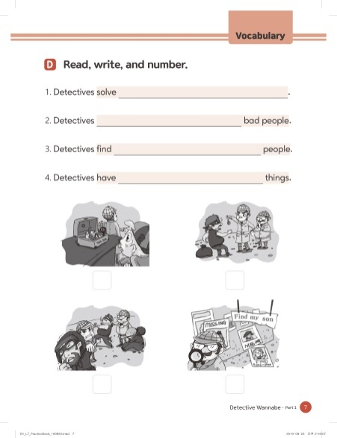
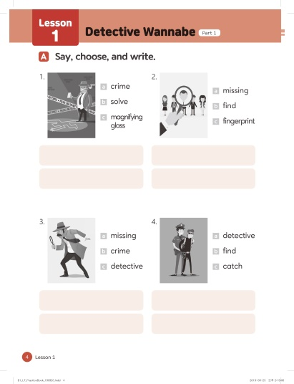
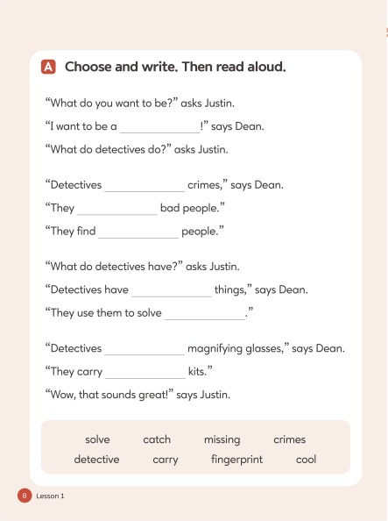
Learning Flow: Student Book & Practice Book (Level 5-10)
Vocabulary
Word Intro & Practice
Chunk Intro & Practice
Word Recognition
Chunk Recognition

Slide 21
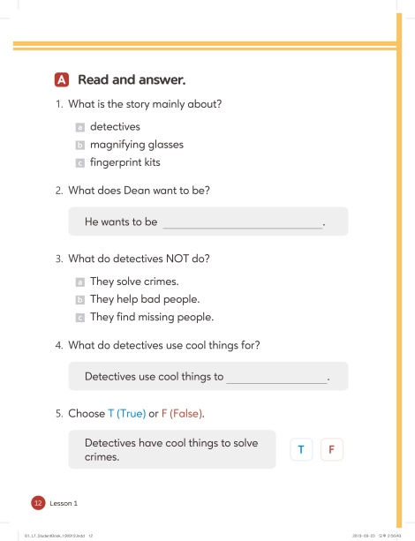
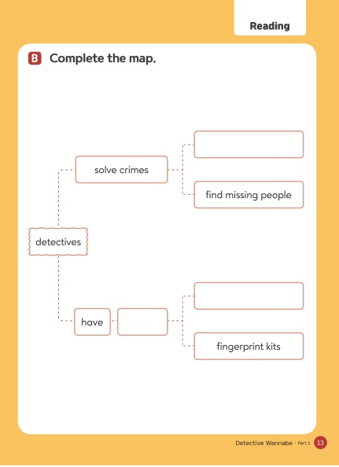

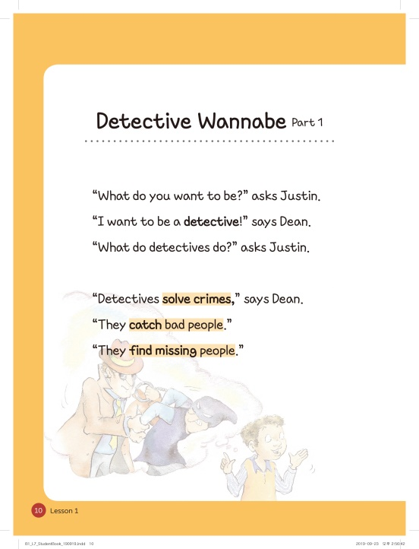
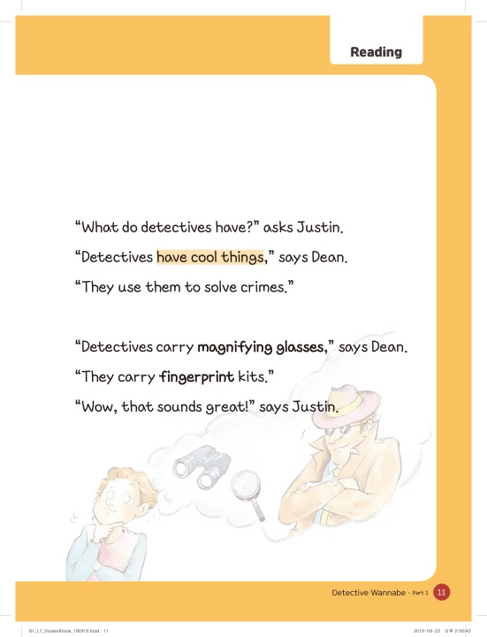


Learning Flow: Student Book & Practice Book (Level 6-10)
Reading
Knowledge Activation
Reading Comprehension
& Summary
Passage

Slide 22






Learning Flow: Student Book & Practice Book (Level 5-10)
Speaking & Writing
Speaking
Writing

Slide 23
Assessment
Level Test
Test Type | Listening | Reading | Placement
Beginner | N/A | 20 | Level 1-5
Intermediate | 10 | 20 | Level 6-10
Class Test
Test Type | Frequency |  | # of Questions
Review Quiz | Every Unit/Lesson | 24 | 10
Book Test | Every Book | 4 | 20 ~ 30
Achievement Test | Every Level | 1 | 30 ~ 50
*The detail information is subject to change.

Slide 24






Learning Platform: Loudclass

Slide 25


Learning Platform: Loudclass
Digital Textbook

Slide 26

Learning Platform: Loudclass
Tools
Blackboard
Enlarge
Resources
Zoom
Highlight
Blind
Text
Pen
Stickers
Eraser
Pen Color
Pen Size
Participation
Grouping
Timer
Next page

Slide 27

Learning Platform: Loudclass
Function: Embedded Answers
book
pencil
bag
ruler
board

Slide 28


Learning Platform: Loudclass
Function: Audio

Slide 29

Learning Platform: Loudclass
Function: Video

Slide 30

Learning Platform: Loudclass
Function: Image

Slide 31

Learning Platform: Loudclass
Function: Internet

Slide 32

Learning Platform: Loudclass
Function: Board

Slide 33



Learning Platform: Loudclass
Function: Timer and More

Slide 34









Phonics APP
Perceive
Play
Phoneme Introduction
Word Recognition
Game Challenge
Perform
Phonics Song
Song Performance
Song Performance

